Slide 1
CSC 453
Database Technologies
Sykes
Week 1

Slide 2
Everything in D2L.
Check D2L news and forum regularly
Post questions to the D2L forum when possible rather than waiting until class
Communicate via email and D2L forum – not voicemail

Slide 3
The highest two exams, one from each half, count.
No makeup for a missed exam or repeat for low passing score.
Exams based on lectures, text, online materials and homework assignments.
Homework is due at the beginning of class.
Late assignments/exams are not accepted.
Mac users - be sure to submit a PC formatted document.
D2L time is the determinant for all submissions.
Lowest homework grade is dropped.
This class does not presume any prior knowledge about databases.
Some of you will already know Oracle, in which case it will likely be an easy A.
The beginning and ending focus will be on general database theory, and not specific to Oracle.
The programming prerequisite is for SQL, which will be more in-depth than the undergrad intro class.

Slide 4
Why a Database (and not a spreadsheet)?
You have too many separate files or too much data in a single file
You need to look at the data in many different ways
You need to share the data
You want to secure access to the data and control data values

Slide 5
List Modification Issues
Redundancy and multiple themes create modification problems:
  Deletion problems
  Update problems
  Insertion problems

Slide 6
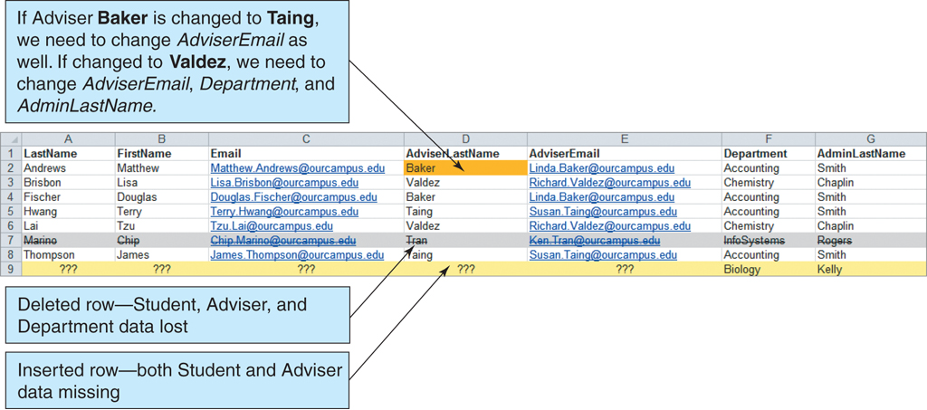
List Modification Issues
The Student with Adviser and Department List

Slide 7
Relational Databases
A relational database stores information in tables. Each informational topic is stored in its own table.
In essence, a relational database will break-up a list into several parts—one part for each theme in the list.
A Project List would be divided into a CUSTOMER Table, a PROJECT Table, and a PROJECT_MANAGER Table.

Slide 8
Sounds Like More Work, Not Less
A relational database is more complicated than a list.
However, a relational database minimizes data redundancy, preserves complex relationships among topics, and allows for partial data.
Furthermore, a relational database provides a solid foundation for user forms and reports.

Slide 9
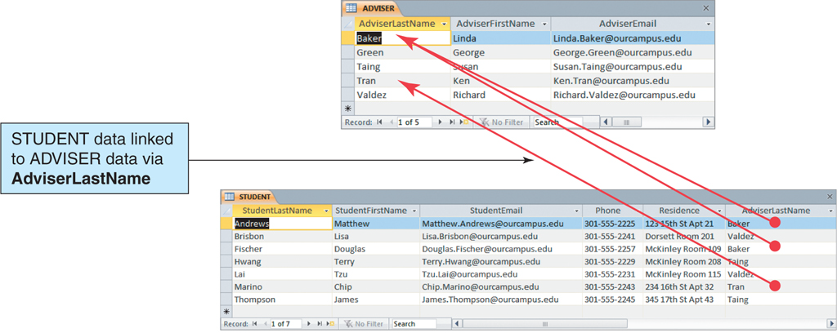
Relational Database Example
The Adviser and Student Tables

Slide 10
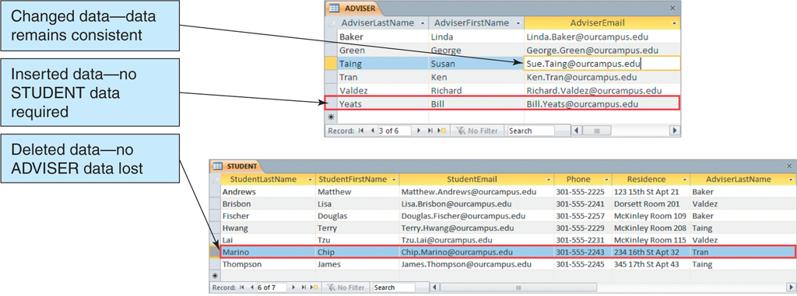
A Relational Database Solves the Problems of Lists
Modifying the Adviser and Student Tables

Slide 11
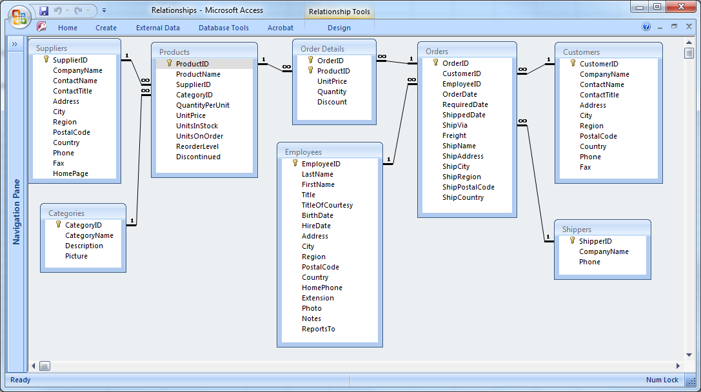
Northwind Database Access 2003
A database can enforce the relationships between the components.

Slide 12
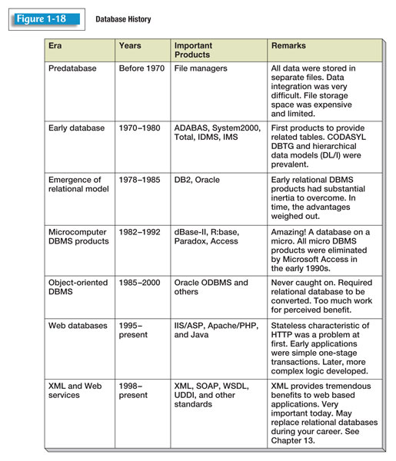

Slide 13
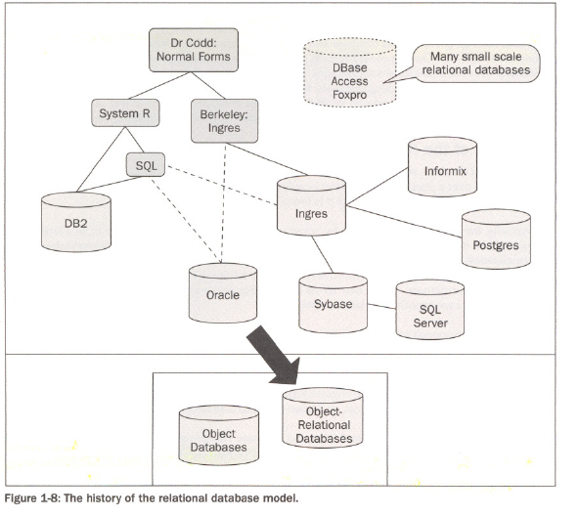
Powell - The development path of the different relational database vendors proceeded as follows. Development from one database to another usually resided in different companies, and was characterized by movement of personnel rather than of database source code. In other words, the people invented the different databases (not the companies), and people moved between different companies.

Slide 14
Introduction
Database
  Collection of related data
  Known facts that can be recorded and that have implicit meaning
  Miniworld or universe of discourse (UoD)
  Represents some aspect of the real world
  Logically coherent collection of data with inherent meaning
  Built for a specific purpose

Slide 15
Database
Other definitions:
C.J. Date: A database is a collection of persistent (i.e. must be explicitly removed) data that is used by the application systems of some given enterprise.
Connolly & Begg: A database is a shared collection of logically related data, and a description of this data, designed to meet the information needs of an organization.
Note that data is related (i.e. not a random assortment) and has meaning. The description of the data is referred to as metadata (data dictionary, catalog,…), and is a standard associated component.

Slide 16
Self-Describing Nature of a Database System
Database system contains complete definition of structure and constraints
Meta-data
  Describes structure of the database
Database catalog used by:
  DBMS software
  Database users who need information about database structure

Slide 17
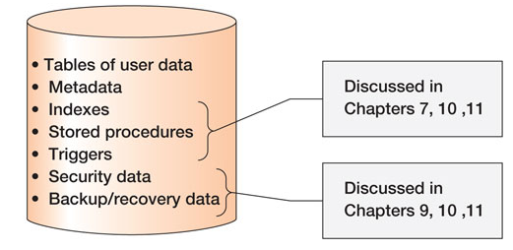
Database Contents

Slide 18


Slide 19
Database Management System (DBMS)
A database management system (DBMS) is a general-purpose software system that facilitates the processes of defining, constructing, manipulating, and sharing databases among various users and applications.
Others:
Connolly & Begg: A DBMS is a software systems that enables users to define, create, maintain, and control access to the database.
Ullman & Widom (web): DBMS: System for providing EFFICIENT, CONVENIENT, and SAFE MULTI-USER storage of and access to MASSIVE amounts of PERSISTENT data.

Slide 20
Advantages of Using the DBMS Approach
Controlling redundancy
  Data normalization
  Denormalization
    Sometimes necessary to use controlled redundancy to improve the performance of queries
Restricting unauthorized access
  Security and authorization subsystem
  Privileged software

Slide 21
Advantages of Using the DBMS Approach (cont'd.)
Providing persistent storage for program objects
  Complex object in C++ can be stored permanently in an object-oriented DBMS
  Impedance mismatch problem
    Object-oriented database systems typically offer data structure compatibility

Slide 22
Advantages of Using the DBMS Approach (cont'd.)
Providing storage structures and search techniques for efficient query processing
  Indexes
  Buffering and caching
  Query processing and optimization

Slide 23
Advantages of Using the DBMS Approach (cont'd.)
Providing backup and recovery
  Backup and recovery subsystem of the DBMS is responsible for recovery
Providing multiple user interfaces
  Graphical user interfaces (GUIs)
Representing complex relationships among data
  May include numerous varieties of data that are interrelated in many ways

Slide 24
Advantages of Using the DBMS Approach (cont'd.)
Enforcing integrity constraints
  Referential integrity constraint
    Every section record must be related to a course record
  Key or uniqueness constraint
    Every course record must have a unique value for Course_number
  Business rules
  Inherent rules of the data model

Slide 25
Advantages of Using the DBMS Approach (cont'd.)
Permitting inferencing and actions using rules
  Deductive database systems
    Provide capabilities for defining deduction rules
    Inferencing new information from the stored database facts
  Trigger
    Rule activated by updates to the table
  Stored procedures
    More involved procedures to enforce rules

Slide 26
Advantages of Using the DBMS Approach (cont'd.)
Additional implications of using the database approach
  Reduced application development time
  Flexibility
  Availability of up-to-date information
  Economies of scale

Slide 27
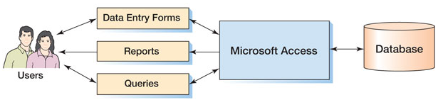
Components of a Database System: Microsoft Access

Slide 28
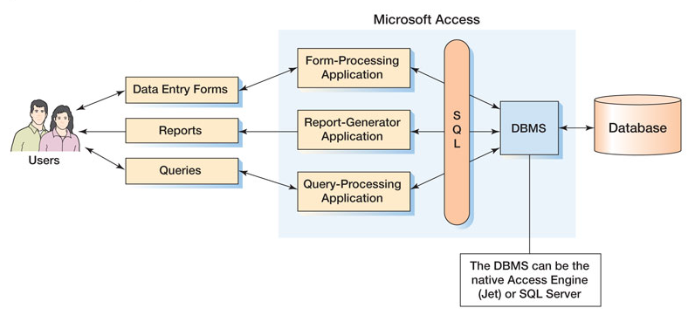
MS Access in Detail

Slide 29
Data Models, Schemas, and Instances
Data abstraction
  Suppression of details of data organization and storage
  Highlighting of the essential features for an improved understanding of data

Slide 30
Data Models, Schemas, and Instances
Data model
  Collection of concepts that describe the structure of a database
  Provides means to achieve data abstraction
  Basic operations
    Specify retrievals and updates on the database
  Dynamic aspect or behavior of a database application
    Allows the database designer to specify a set of valid operations allowed on database objects

Slide 31
Categories of Data Models
High-level or conceptual data models
  Close to the way many users perceive data
Low-level or physical data models
  Describe the details of how data is stored on computer storage media
Representational data models
  Easily understood by end users
  Also similar to how data organized in computer storage

Slide 32
Categories of Data Models
Entity
  Represents a real-world object or concept
Attribute
  Represents some property of interest
  Further describes an entity
Relationship among two or more entities
  Represents an association among the entities
  Entity-Relationship model

Slide 33
Schemas, Instances, and Database State
Database schema
  Description of a database
Schema diagram
  Displays selected aspects of schema
Schema construct
  Each object in the schema
Database state or snapshot
  Data in database at a particular moment in time

Slide 34
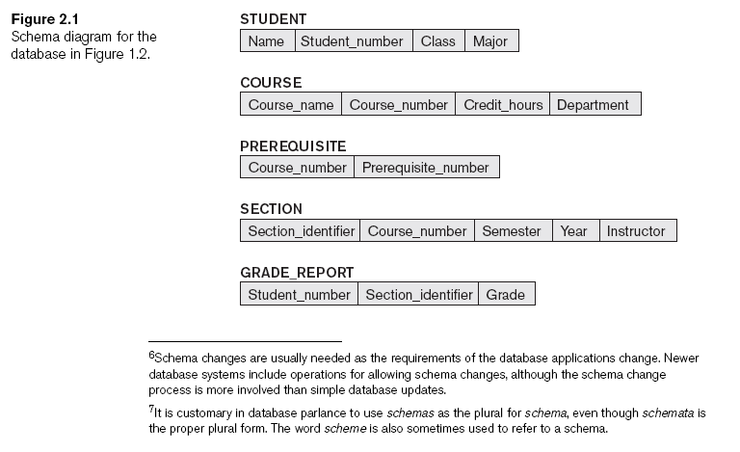
Schemas, Instances, and Database State

Slide 35
ANSI–SPARC Architecture
In 1975 the American National Standards Institute Standards Planning and Requirements Committee (ANSI/SPARC ) proposed a 3 level architecture, including a catalog, for database systems:
External level - user view(s), external schemas or subschemas, of some part of the data; unused portion is essentially hidden. Data may be derived from multiple entities.
Conceptual level - conceptual schema describes the structure of entire database, i.e. what data is stored: all entities, attributes, relationships, data constraints, and security and integrity information. No storage specific considerations included.
Internal level - internal schema describes the physical structure of the database, i.e. how data is stored: storage space allocation for data and indexes, record descriptions, sizes for data items (or numeric format), physical sequence of records, data compression and encryption techniques.

Slide 36
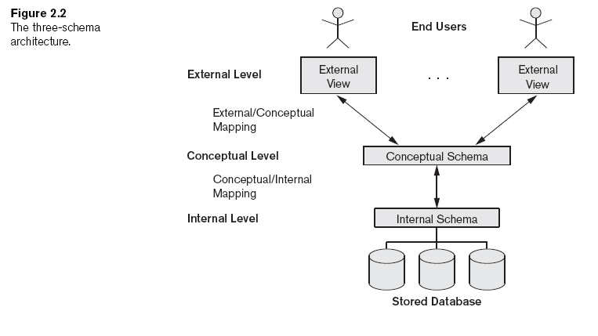
Three-Schema Architecture and Data Independence

Slide 37
ANSI–SPARC Architecture
One internal schema, one conceptual schema, multiple external schemas.
All are just descriptions of the data, which actually exists only at the physical storage level.
DBMS provides mapping between the external and conceptual levels and between the conceptual and internal levels.
(ANSI/SPARC is not an official standard, but a common framework for discussion. Not formally implemented due to overhead in multiple mappings; generally only two formal levels.)

Slide 38
Data Independence
Three level architecture, with mapping, provides for data independence.
Logical data independence - can change the conceptual schema to expand or reduce the database without having to change unaffected external schemas or application programs.
Physical data independence - can change the internal schema without having to change conceptual schema. Changes may consist of different storage structures or file organizations or access structures and algorithms.

Slide 39
DBMS Languages
Data definition language (DDL)
  Defines both schemas
Storage definition language (SDL)
  Specifies the internal schema
View definition language (VDL)
  Specifies user views/mappings to conceptual schema
Data manipulation language (DML)
  Allows retrieval, insertion, deletion, modification

Slide 40
Schema vs. Instance
Note there is a distinction between a
database schema - a description of the database; intension (note spelling); less frequent changes
database state - data is an instance of the database at a point in time; extension; frequent changes.

Slide 41
Database Background
Attribute
  Characteristic or property of an entity
  Example: Customer has name, street, city, etc.
  May also be called a field or column
Relationship
  Association between entities
  One-to-many relationship
    Each rep is associated with many customers
    Each customer is associated with a single rep

Slide 42
Relational Databases
A relational database is a collection of tables
Each entity is stored in its own table
Attributes of an entity become the fields or columns in the table
Relationships are implemented through common columns in two or more tables
Should not permit multiple entries (repeating groups) in a table

Slide 43
Relational Databases
Relation: two-dimensional table in which:
  Entries are single-valued
  Each column has a distinct name (called the attribute name)
  All values in a column are values of the same attribute
  Order of columns is immaterial
  Each row is distinct
  Order of rows is immaterial
  Domain is the set of allowable values for one or more attributes.

Slide 44
Relational Model Terminology
Tuple is a row of a relation.
Degree is the number of attributes in a relation.
Cardinality is the number of tuples in a relation.
Relational Database is a collection of normalized relations with distinct relation names.

Slide 45
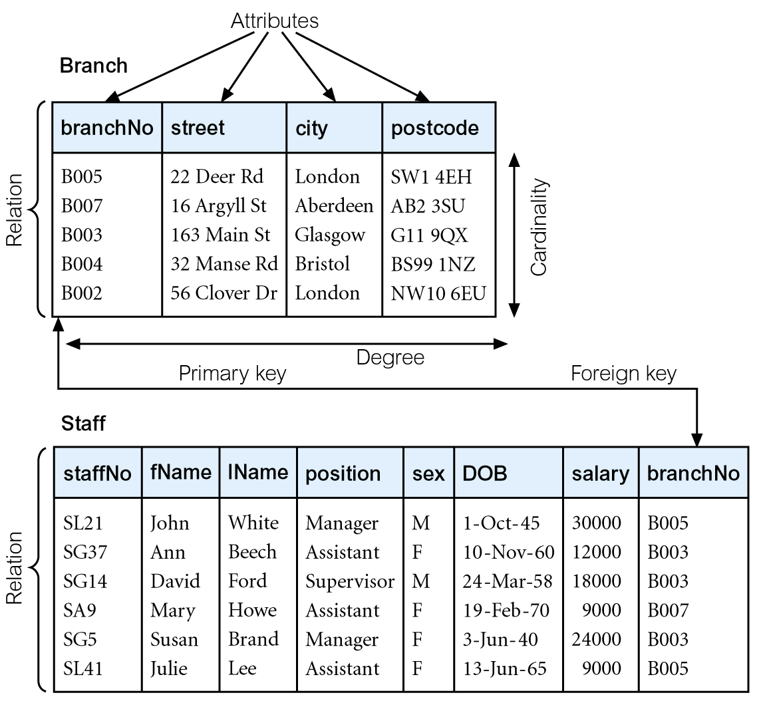
Instances of Branch and Staff Relations

Slide 46
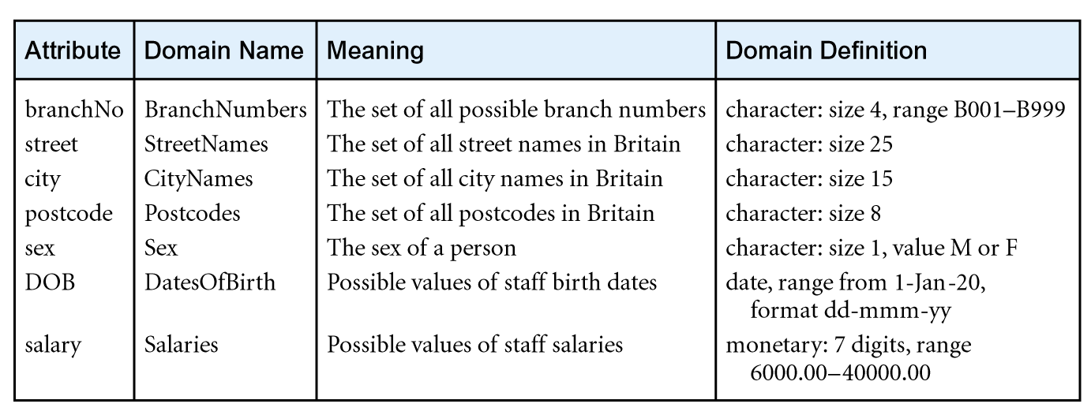
Examples of Attribute Domains

Slide 47
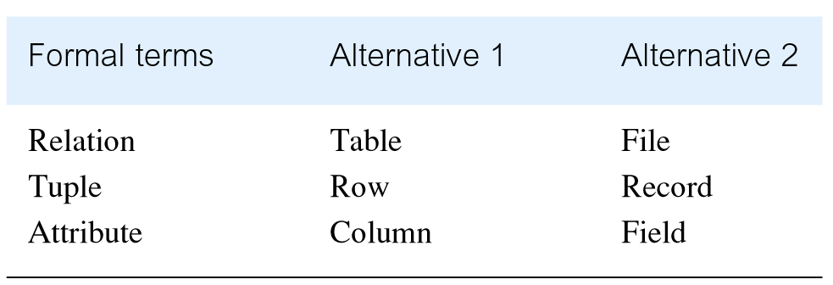
Alternative Terminology for Relational Model

Slide 48
Relational Databases
Relational database: collection of relations
Unnormalized relation
  A structure that satisfies all properties of a relation except for the first item
  Entries contain repeating groups; they are not single-valued

Slide 49
Relational Databases
Database structure representation
  Write name of the table followed by a list of all columns within parentheses
  Each table should appear on its own line
  Notation to be used with duplicate column names within a database: Tablename.Columnname
    You qualify the column names
Primary key: column or collection of columns of a table (relation) that uniquely identifies a given row in that table

Slide 50
Introduction
Levels at which we can discuss goodness of relation schemas
  Logical (or conceptual) level
  Implementation (or physical storage) level
Approaches to database design:
  Bottom-up or top-down

Slide 51
Informal Design Guidelines for Relation Schemas
Measures of quality
  Making sure attribute semantics are clear
  Reducing redundant information in tuples
  Reducing NULL values in tuples
  Disallowing possibility of generating spurious tuples

Slide 52
Imparting Clear Semantics to Attributes in Relations
Semantics of a relation
  Meaning resulting from interpretation of attribute values in a tuple
Easier to explain semantics of relation
  Indicates better schema design

Slide 53
Guideline 1
Design relation schema so that it is easy to explain its meaning
Do not combine attributes from multiple entity types and relationship types into a single relation
Example of violating Guideline 1: Figure 15.3

Slide 54
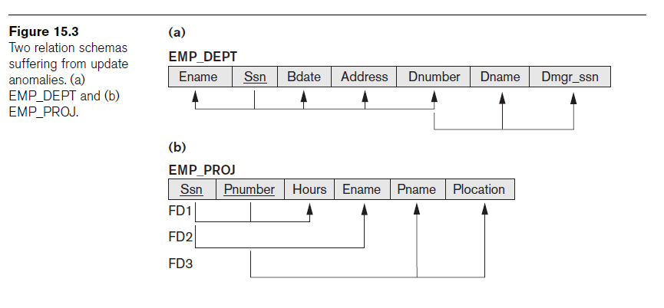
Guideline 1 (cont’d.)

Slide 55
Guideline 2
Design base relation schemas so that no update anomalies are present in the relations
If any anomalies are present:
  Note them clearly
  Make sure that the programs that update the database will operate correctly

Slide 56
NULL Values in Tuples
May group many attributes together into a “fat” relation
  Can end up with many NULLs
Problems with NULLs
  Wasted storage space
  Problems understanding meaning

Slide 57
Guideline 3
Avoid placing attributes in a base relation whose values may frequently be NULL
If NULLs are unavoidable:
  Make sure that they apply in exceptional cases only, not to a majority of tuples

Slide 58
Summary and Discussion of Design Guidelines
Anomalies cause redundant work to be done
Waste of storage space due to NULLs
Difficulty of performing operations and joins due to NULL values

Slide 59
Functional Dependencies
Formal tool for analysis of relational schemas
Enables us to detect and describe some of the above-mentioned problems in precise terms
Theory of functional dependency

Slide 60
Functional Dependencies
Important concept associated with normalization.
Functional dependency describes relationship between attributes.
For example, if A and B are attributes of relation R, B is functionally dependent on A (denoted A → B), if each value of A in R is associated with exactly one value of B in R.

Slide 61

Characteristics of Functional Dependencies
Property of the meaning or semantics of the attributes in a relation.
Diagrammatic representation.
The determinant of a functional dependency refers to the attribute or group of attributes on the left-hand side of the arrow.

Slide 62


Characteristics of Functional Dependencies

Slide 63
Characteristics of Functional Dependencies
Determinants should have the minimal number of attributes necessary to maintain the functional dependency with the attribute(s) on the right hand-side.
This requirement is called full functional dependency.

Slide 64
Characteristics of Functional Dependencies
Full functional dependency indicates that if A and B are attributes of a relation, B is fully functionally dependent on A if B is functionally dependent on A, but not on any proper subset of A.

Slide 65
Example Full Functional Dependency
Exists in the Staff relation.
staffNo, sName → branchNo
True - each value of (staffNo, sName) is associated with a single value of branchNo.
However, branchNo is also functionally dependent on a subset of (staffNo, sName), namely staffNo. Example above is a partial dependency.

Slide 66
Characteristics of Functional Dependencies
Main characteristics of functional dependencies used in normalization:
  There is a one-to-one relationship between the attribute(s) on the left-hand side (determinant) and those on the right-hand side of a functional dependency.
  Holds for all time.
  The determinant has the minimal number of attributes necessary to maintain the dependency with the attribute(s) on the right hand-side.

Slide 67
Definition of Functional Dependency (cont’d.)
Given a populated relation
  Cannot determine which FDs hold and which do not
  Unless meaning of and relationships among attributes known
  Can state that FD does not hold if there are tuples that show violation of such an FD

Slide 68
A Key
A key is one (or more) column(s) of a relation that is (are) used to identify a row.

Slide 69
A Composite Key
A composite key is a key that contains two or more attributes.
For a key to be unique, it must often become a composite key.

Slide 70
Keys
Column A (or a collection of columns) is the primary key for a relation R
  Property 1: all columns in R are functionally dependent on A
  Property 2: no subcollection of columns in A also have Property 1
Candidate key: column(s) on which all columns in table are functionally dependent
Alternate keys: candidate keys not chosen as primary key

Slide 71
Relational Keys
Primary Key
  Candidate key selected to identify tuples uniquely within relation.
Alternate Keys
  Candidate keys that are not selected to be primary key.
Foreign Key
  Attribute, or set of attributes, within one relation that matches candidate key of some (possibly same) relation.

Slide 72
Relational Keys
Superkey
  An attribute, or set of attributes, that uniquely identifies a tuple within a relation.
Candidate Key
  Superkey (K) such that no proper subset is a superkey within the relation.
  In each tuple of R, values of K uniquely identify that tuple (uniqueness).
  No proper subset of K has the uniqueness property (irreducibility).

Slide 73
Using sample data to identify functional dependencies.
Consider the data for attributes denoted A, B, C, D, and E in the Sample relation.
Important to establish that sample data values shown in relation are representative of all possible values that can be held by attributes A, B, C, D, and E. Assume true despite the relatively small amount of data shown in this relation.

Slide 74
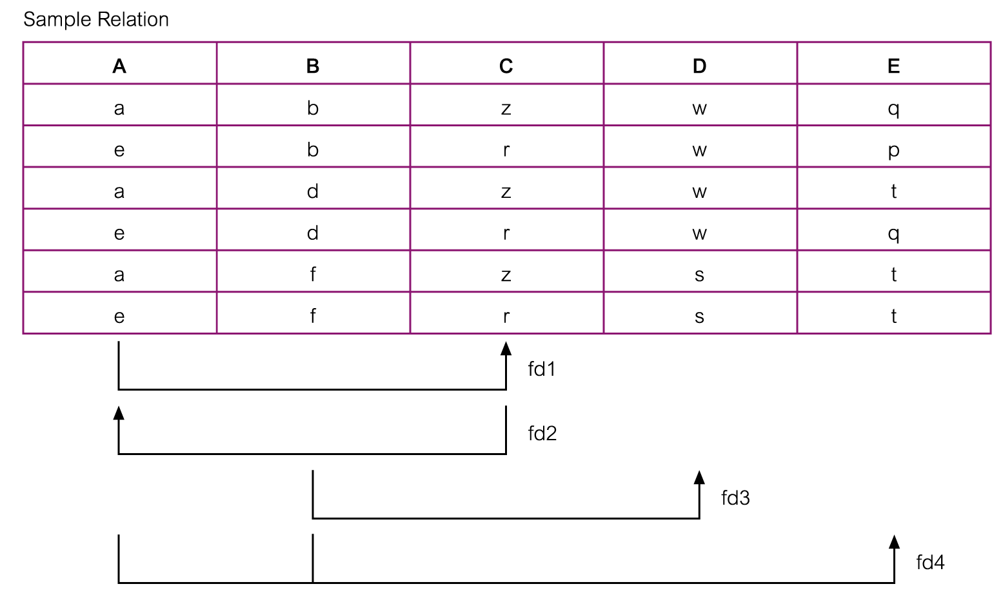
Using sample data to identify functional dependencies.

Slide 75
Using sample data to identify functional dependencies.
Function dependencies between attributes A to E in the Sample relation.
A → C (fd1)
C → A (fd2)
B → D (fd3)
A, B → E (fd4)

Slide 76
Identifying the Primary Key using Functional Dependencies
Main purpose of identifying a set of functional dependencies for a relation is to specify the set of integrity constraints that must hold on a relation.
An important integrity constraint to consider first is the identification of candidate keys, one of which is selected to be the primary key for the relation.

Slide 77
Identifying Primary Key for Sample Relation
Sample relation has four functional dependencies.
The determinants in the Sample relation are A, B, C, and (A, B). However, the only determinant that functionally determines all the other attributes of the relation is (A, B).
(A, B) is identified as the primary key for this relation.

Slide 78
A Surrogate Key
A surrogate key is a unique, numeric value that is added to a relation to serve as the primary key.
Surrogate key values have no meaning to users and are usually hidden on forms, queries, and reports.
A surrogate key is often used in place of a composite primary key.

Slide 79
Relationships Between Tables
A table may be related to other tables.
For example
  An Employee works in a Department
  A Manager controls a Project

Slide 80
A Foreign Key
To preserve relationships, you may need to create a foreign key.
A foreign key is a primary key from one table placed into another table.
The key is called a foreign key in the table that received the key.

Slide 81
Foreign Key Example I
Project
ProjID
ProjName
MgrID
Manager
MgrID
MgrName
Primary Key
Foreign Key

Slide 82
Foreign Key Example II
Department
DeptID
DeptName
Location
Employee
EmpID
DeptID
EmpName
Primary Key
Foreign Key

Slide 83
Referential Integrity
Referential integrity states that every value of a foreign key must match a value of an existing primary key.
Example (see previous slide):
  If EmpID = 4 in EMPLOYEE has a DeptID = 7 (a foreign key), a Department with DeptID = 7 must exist in DEPARTMENT.
  The primary key value must exist before the foreign key value is entered.

